Slide 1
SESSION 10
Cloud Training Jobs & Experiment Tracking
Azure ML SDK v2 | MLflow | Sweep Jobs | Model Registry
Day 2 | 11:00 AM – 12:00 PM | 60 minutes

Slide 2
OBJECTIVES
What You'll Master Today
01 Submit Cloud Training Jobs
Run training scripts on Azure ML Compute Clusters using SDK v2
02 Track with MLflow
Log params, metrics & artifacts — autolog() or manual logging
03 Cloud-Scale HPO
Sweep Jobs with Bayesian sampling + Bandit early termination
04 Compare Runs in Studio
Select multiple runs → Compare view → parallel coordinates chart
05 Register Best Model
Promote model: experiment → staging → production
2

Slide 3
CORE CONCEPTS
Azure ML Job Types
Command Job
Sweep Job
Pipeline Job
AutoML Job
Single-script training run
Hyperparameter optimization at scale
Multi-step ML workflow
Automated model selection
• Simple & fast to configure
• 30+ parallel trials
• DAG of reusable components
• No-code experimentation
• Wrap any Python script
• Bayesian or random sampling
• Data prep → train → evaluate
• Azure chooses algorithm
• Submit from SDK or YAML
• Bandit early termination
• Cacheable steps
• Benchmark quickly
3

Slide 4
JOB LIFECYCLE
From SDK to Cloud Compute — 8-Stage Lifecycle
1
2
3
4
5
6
7
8
Define Job
Upload Code
Provision
Pull Env
Execute
Log MLflow
Save Outputs
Register
→
→
→
→
→
→
→
SDK v2 / YAML
Snapshot → Blob
Cluster auto-scales
Docker ← ACR cache
train.py runs
params + metrics
model → Blob
Model Registry
4

Slide 5
COMMAND JOB
Submitting a Training Job — SDK v2
from azure.ai.ml import MLClient, command, Input
Key Parameters
from azure.identity import DefaultAzureCredential
ml_client = MLClient(
compute
DefaultAzureCredential(),
Target cluster name (auto-scales 0 → N nodes)
subscription_id, resource_group, workspace
)
environment
job = command(
Versioned Docker env (cached in ACR)
code='./scripts',
command='python train.py --lr 0.05',
environment='azureml:credit-model-env:1',
code
compute='cpu-cluster',
Local folder snapshot uploaded to Blob
experiment_name='credit-default-model',
tags={'framework': 'sklearn'}
)
experiment
Groups related runs in Studio dashboard
returned_job = ml_client.jobs.create_or_update(job)
print('Studio URL:', returned_job.studio_url)
5

Slide 6
MLFLOW TRACKING
Experiment Tracking — Auto vs. Manual
mlflow.autolog()
Manual mlflow.log_*()
One line captures everything
Fine-grained per-metric control
import mlflow
with mlflow.start_run():
mlflow.autolog() # done!
mlflow.log_param('lr', lr)
mlflow.log_metric(
Auto-captures:
'val_auc', val_auc,
• All __init__ parameters
step=epoch
• Training score
)
• Feature importances
mlflow.log_figure(
• Fitted model artifact
fig, 'confusion.png'
)
Works with: sklearn, XGBoost,
mlflow.sklearn.log_model(
PyTorch, TensorFlow
model, 'model')
Best for: Quick experiments & benchmarks
Best for: Production pipelines & custom metrics
6

Slide 7
SWEEP JOBS
Cloud-Scale Hyperparameter Optimization
from azure.ai.ml.sweep import Choice, Uniform, BanditPolicy
Sampling Algorithms
sweep_job = command_job.sweep(
Random
sampling_algorithm='bayesian',
Baseline
primary_metric='val_auc',
No learning between trials
goal='Maximize',
search_space={
Grid
'learning_rate': Uniform(0.001, 0.1),
Small spaces
'max_depth': Choice([3, 5, 7, 10]),
All combos; exhaustive
'n_estimators': Choice([100, 200, 300, 500])
},
limits={
Bayesian
Best: 5x faster
'max_total_trials': 30,
Learns from prev trials
'max_concurrent_trials': 5,
'timeout': 7200
},
Bandit Policy — Cost Control
early_termination_policy=BanditPolicy(
Kills trials >10% behind the current best. Saves up to 60% compute vs. running all trials to completion.
slack_factor=0.1,
evaluation_interval=1
)
)
7

Slide 8
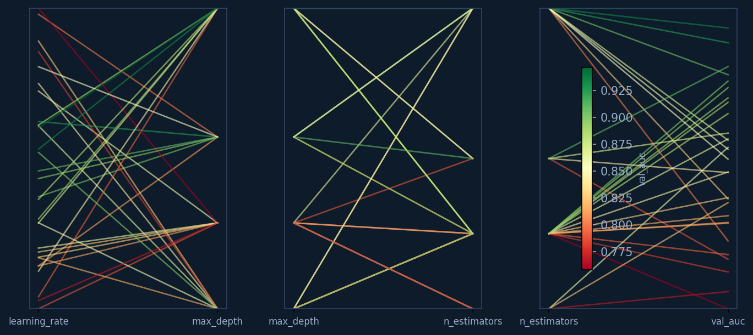
SWEEP VISUALISATION
Reading the Parallel Coordinates Chart
How to Read It
Green lines = high val_auc (good hyperparameter combos)
Red lines = poor trials (terminated early by Bandit)
Steep angles show strong param–metric correlations
Cluster of green lines = optimal search region
8

Slide 9
ENVIRONMENTS
Reproducible Environments — Docker + Conda
env = Environment(
Environment Lifecycle
name='credit-model-env',
version='1',
1. Define
conda_file='environment.yml',
Python SDK or conda YAML
image='mcr.microsoft.com/azureml/
2. Register
openmpi4.1.0-ubuntu20.04:latest'
Stored in workspace registry
)
ml_client.environments.create_or_update(env)
3. Build
Docker image built in ACR (~10 min first time)
# environment.yml
4. Cache
name: credit-model-env
Subsequent jobs pull from ACR (<1 min)
dependencies:
- python=3.10
- pip:
5. Audit
- scikit-learn==1.3.0
Every model links to exact env version
- mlflow==2.7.0
- pandas==2.0.3
9

Slide 10
STUDIO NAVIGATION
Comparing Runs in Azure ML Studio
Azure ML Studio
→
Jobs
→
credit-default-model
→
Runs
→
Compare
01
Navigate to Jobs
02
Select Multiple Runs
03
Click Compare
Studio home → Jobs (left sidebar) Select your experiment: 'credit-default-model'
Ctrl+Click 3 or more runs in the table Runs are sortable by any column
Top toolbar → Compare button Opens side-by-side metric view
04
Parallel Coordinates
05
Promote Best Run
Switch to 'Parallel Coordinates' tab Color = primary metric (val_auc)
Right-click best run → Register Model Directly promotes to Model Registry
10

Slide 11
MODEL REGISTRY
Model Registry — Versioning & Promotion
Experiment Run
Registered (None)
Staging
Production
Archived
Raw MLflow run No registry entry
→
Name + version assigned Full lineage stored
→
Undergoing QA/testing CI/CD validation gate
→
Live serving traffic Champion model
→
Deprecated Kept for audit
model = Model(
path=f'azureml://jobs/{job_name}/outputs/model',
name='credit-default-classifier',
type=AssetTypes.MLFLOW_MODEL,
tags={'val_auc': '0.923', 'framework': 'sklearn', 'session': '10'}
)
registered = ml_client.models.create_or_update(model)
print(f'Registered: {registered.name} v{registered.version}')
11

Slide 12
STUDIO NAVIGATION
Azure ML Studio — Navigation Map for AI & MLOps
Jobs
Data
Models
• All submitted jobs
• Datastores (connections)
• Version history
• Experiment groups
• Data Assets (versioned)
• Tags & lineage
• Job logs & outputs
• Upload & preview
• Deploy endpoint
• Child runs (Sweep)
• URI path management
• Promote label
Compute
Environments
Endpoints
• Compute Instances
• Curated (ready-to-use)
• Online (real-time API)
• Compute Clusters
• Custom (yours)
• Batch (large datasets)
• Inference Clusters
• Build logs (ACR)
• Deployment versions
• Serverless compute
• Package details
• Traffic splitting
12

Slide 13
TAKEAWAYS
Key Takeaways
Cloud training removes all local resource limits
Run 30 parallel trials on GPU/CPU clusters while you sleep — zero local overhead
mlflow.autolog() is your fastest start
One line captures all params, metrics, and the fitted model — no boilerplate
Sweep Jobs = Optuna at cloud scale
Bayesian sampling + Bandit early termination → converges 5x faster than random
Environments enforce reproducibility
Versioned Docker + conda spec, cached in ACR — same result 6 months later
Model Registry formalizes your promotion path
experiment → staging → production with full lineage, tags, and audit trail
13

